Slide 1

ANGULAR 4

Slide 2
Angular Modules
Types of Feature Modules
Eager Loading
Eagerly Loading Routed Modules
Lazy Loading
Lazily Loading Routed Modules
Defining Preload Strategies
Feature Module Types
Identifying Feature Modules

Slide 3
TYPES OF FEATURE MODULES
Angular Modules
Help organize our applications into cohesive blocks of functionality

Slide 4
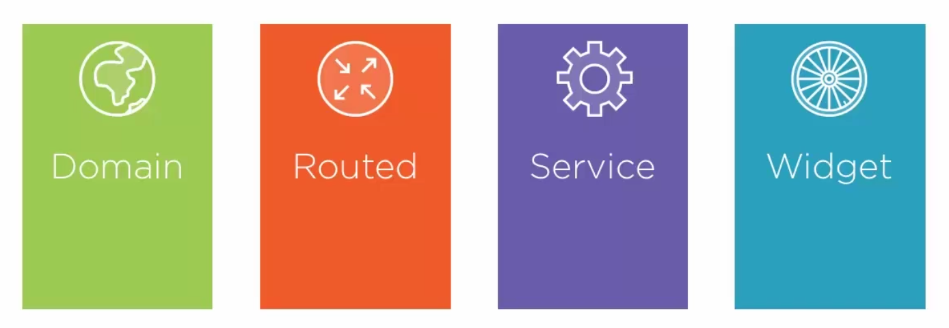
TYPES OF FEATURE MODULES

Slide 5
TYPES OF FEATURE MODULES
Eager Loading
Loading a feature module at startup, with the root module. Begin by creating a feature module with routing.

Slide 6
TYPES OF FEATURE MODULES
Characters.module.ts
Characters-routing.module.ts
Import { ShipsRouterModule } from ‘./ships-routing.module’;
@NgModule({
import: [
CommonModule,
FormsModule,
ShipsRouterModule
],
providers: [ShipsService]
})
Export class ShipsModule { }
Const routes: Routes = [
{
path: ‘ships’,
componente: ShipsComponent,
children: [
{ path: ‘’, component: ShipsList },
{ path: ‘:id’, componente: ship }
]
}
];
@NgModule({
imports: [routerModule.forChild(routes)],
exports: [RouterModule]
})
Export class ShipsrouterModule { }

Slide 7
TYPES OF FEATURE MODULES
app.module.ts
@NgModule({
import: [
BrowserModule,
FormsModule,
HttpModule,
ShipsModule,
AppRoutingModule
],
declarations: [AppComponent]
bootstrap: [AppComponent]
})
Export class AppModule { }
We get the routes automaticly.
Note: Import order is importante.

Slide 8
EAGERLY LOADING ROUTED MODULES
App Module
Demo
Movies Module
Ships Module
Characters Module

Slide 9
LAZY LOADING
Lazy Loading
Loading modules on demand, as needed, just in time.
Lowers the initial payload, improvinf the app startup experience.

Slide 10
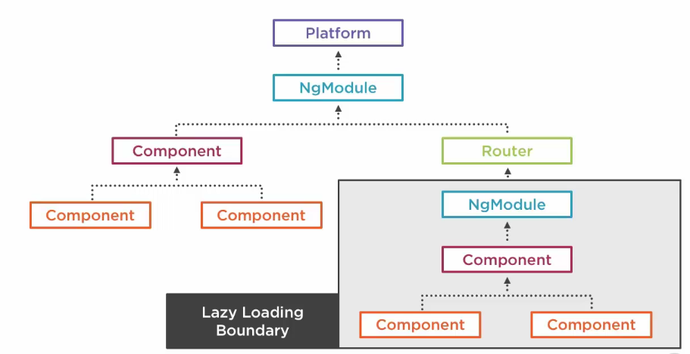
LAZY LOADING

Slide 11
LAZY LOADING
Eager Loading
Lazy Loading
Loads at startup
Ideal for modules users need immediately
Loads on demand
Ideal for modules not immediately in the workflow

Slide 12
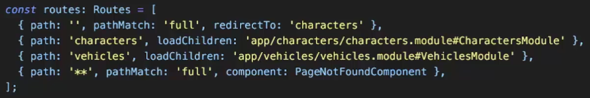
LAZY LOADING
App-routing.module.ts
Use loadChildren
Load the module by path # name

Slide 13
LAZILY LOADING ROUTED MODULES
Demo
App Module
Turn our modules into lazy loaded modules
Movies Module
Ships Module
Characters Module

Slide 14
DEFINING PRELOAD STRATEGIES
Preload strategies
When a user navigates to a lazily loadable module, the contente has to be fetched from the server, whicg may cause a delay.
The router can preload lazily loadable modules in the background.

Slide 15
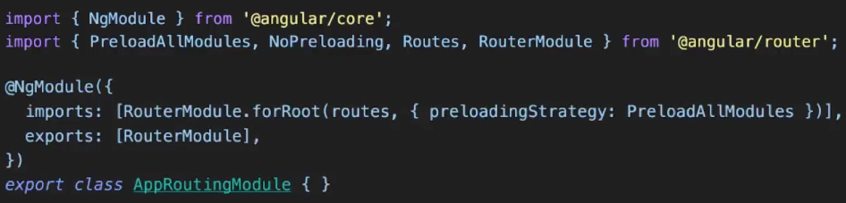
DEFINING PRELOAD STRATEGIES
App-routing.module.ts
Preload Strategies
We can preload all or none, out of the box.
Pass the strategy to forRoot.

Slide 16
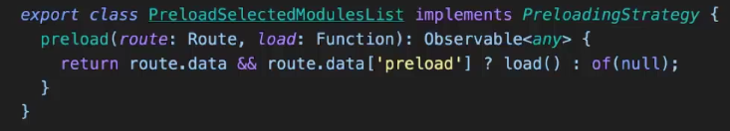
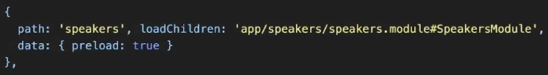
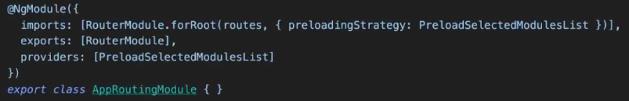
DEFINING PRELOAD STRATEGIES
Custom Preload Strategies
Preload-strategy.ts
Implement the interface
PreloadingStrategy
App-routing.module.ts
App-routing.module.ts

Slide 17
DEFINING PRELOAD STRATEGIES
Demo
Add a Preload strategy to our app.

Slide 18
FEATURE MODULE TYPES

Slide 19
FEATURE MODULE TYPES
Deliver a user experience dedicated to a particular application domain.
Typically imported once by the root AppModule, without routing.
EX: MenuModule, HeaderModule

Slide 20
FEATURE MODULE TYPES
Routed feature modules are Domain feature modules who are the targets of navigation routes.
EX: ShipsModule, MoviesModule

Slide 21
FEATURE MODULE TYPES
Service feature modules contain singleton services used by anyone across the app.
Generally all providers, no components.
We import them once in App Root Module.
NOTE: don’t import this module in any other module.

Slide 22
FEATURE MODULE TYPES
Shared feature modules generally contain components, directives and pipes.
We import these in every module that uses them.

Slide 23
IDENTIFYING FEATURE MODULES
App Module
MenuModule
ServicesModule
CharactersModule
ShipsModule
SharedModule

Slide 24
IDENTIFYING FEATURE MODULES
App Module
MenuModule
MenuComponent
MenuModule
ServicesModule
TreeListComponent
CharactersModule
ShipsModule
SharedModule

Slide 25
IDENTIFYING FEATURE MODULES
App Module
ServicesModule
MenuModule
AuthService
ServicesModule
CharactersModule
ShipsModule
SharedModule

Slide 26
IDENTIFYING FEATURE MODULES
App Module
CharactersModule
MenuModule
Characters-routingModule
ServicesModule
CharactersService
CharactersModule
CharactersComponent
ShipsModule
SharedModule

Slide 27
IDENTIFYING FEATURE MODULES
App Module
MenuModule
ShipsModule
ServicesModule
Ships-routingModule
CharactersModule
ShipsService
ShipsModule
ShipsComponent
SharedModule

Slide 28
IDENTIFYING FEATURE MODULES
App Module
SharedModule
MenuModule
Datagrid Component
ServicesModule
CustomPipe
CharactersModule
CommonModule
ShipsModule
FormsModule
SharedModule

Slide 29
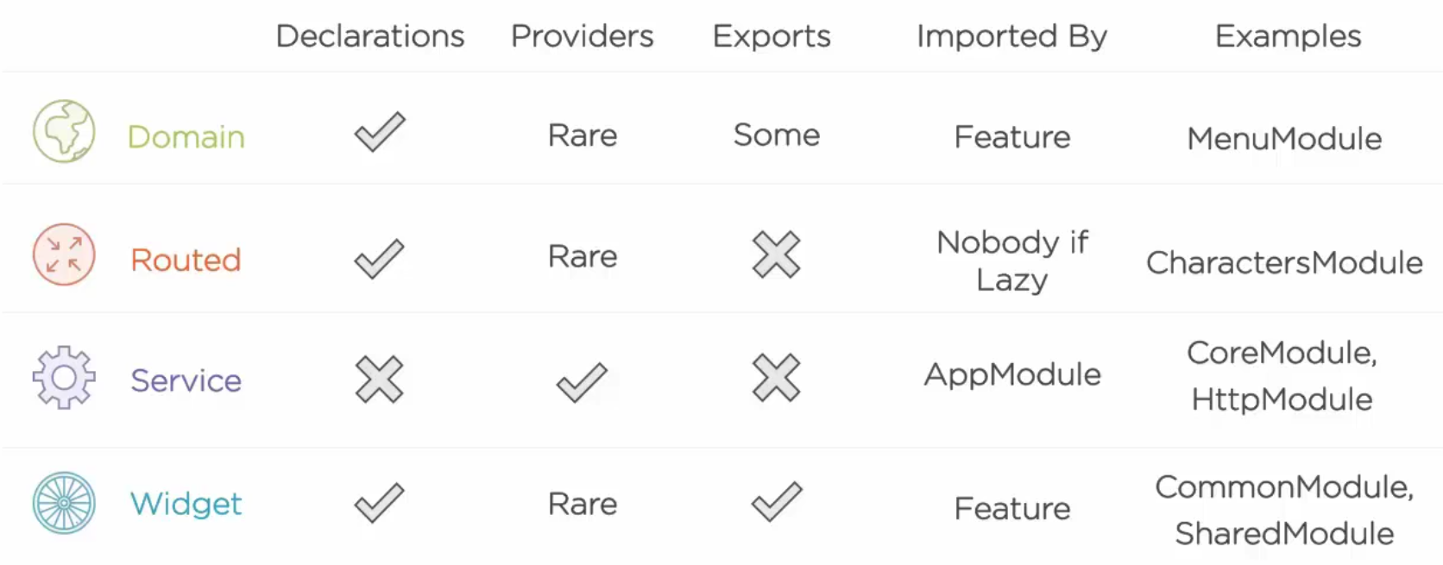
IDENTIFYING FEATURE MODULES

